Slide 1

User Experience and User Interface Design
7 - Android UI Design Introduction - Styles
Dr. Seyed Reza Shahamiri More Info

Slide 2

Style
2
A style is a collection of attributes that specify the look and format for a View or window.
A style can specify attributes such as height, padding, font color, font size, background color, and much more.
This way several Views can use the same style, and in case of any changes, you don’t need to change each View individually; instead, you only need to change the style that needs to be changed.
A style is defined in an XML resource that is separate from the XML that specifies the layout.

Slide 3
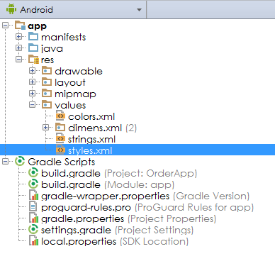
Style Order App
3
In the Order App, find “styles.xml” and open it:

Slide 4
Style
4
You can define new styles between <resources> and </resources> in styles.xml:
<resources> <style name=“Style1Name"> <item name=“Attribute1Name">Attribute1Value</item> <item name=“Attribute2Name">Attribute2Value</item>
</style>
<style name=“Style2Name"> <item name=“Attribute1Name">Attribute1Value</item> <item name=“Attribute2Name">Attribute2Value</item>
</style> </resources>

Slide 5
Style Order App
5
Add the following style:
<style name="HeaderText"> <item name="android:textColor">#EF6C00</item> <item name="android:textStyle">bold</item> <item name="android:textSize">16sp</item> </style>

Slide 6
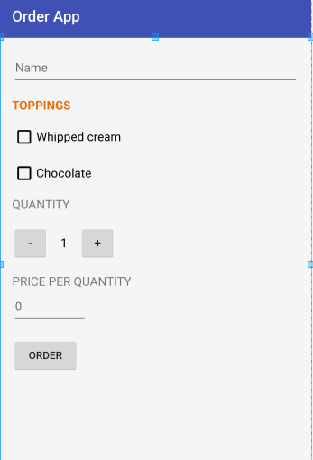
Style Order App
6
Now that you defined a style, you need to mention which Views should be using it.
Open activity_main.xml, remove android:textColor, android:textStyle, and android:textSize attributes of TOPPINGS TextView and add the following attribute:
<TextView style="@style/HeaderText" android:layout_width="wrap_content" android:layout_height="wrap_content" android:layout_marginTop="16dp" android:text="TOPPINGS" />

Slide 7
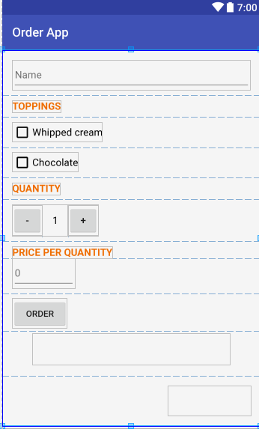
Style Order App
7
Update the “QUANTITY” and “PRICE PER QUANTITY” TextViews too:

Slide 8
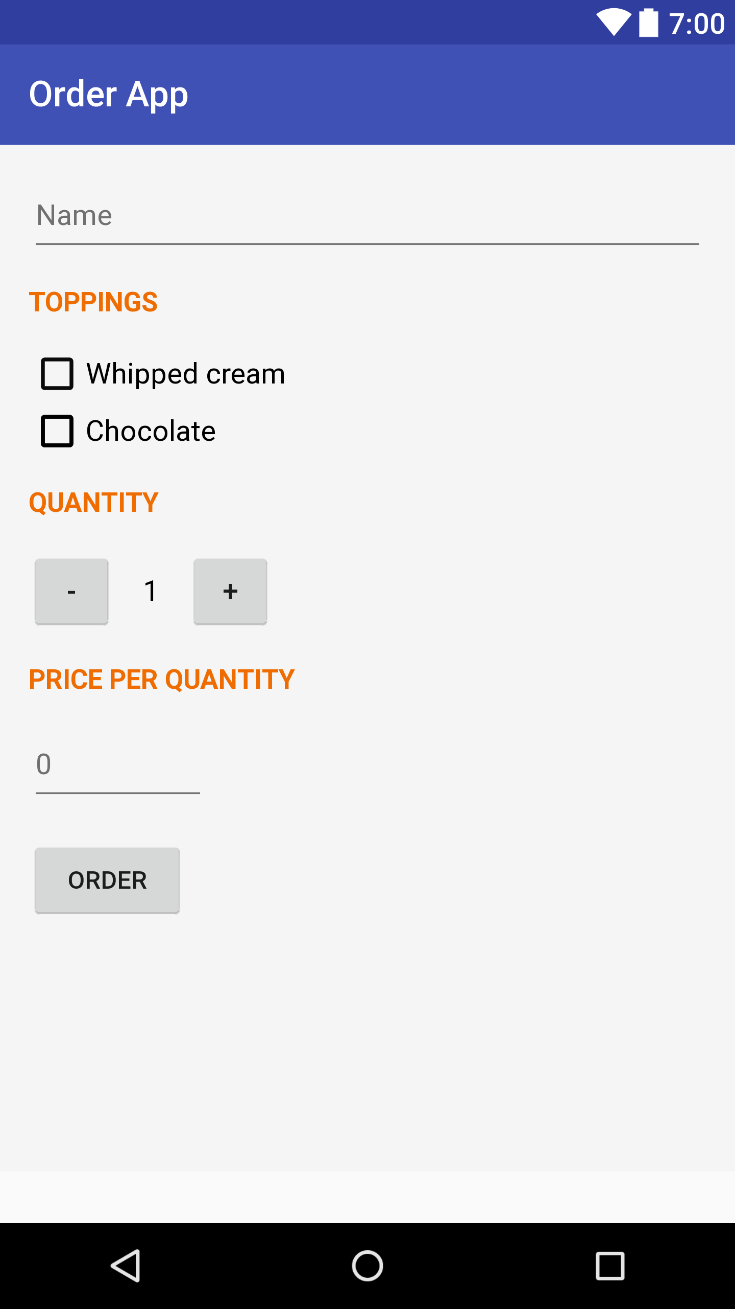
Style Order App
8
Now, add the following attributes to the style:
layout_width to set wrap_content
layout_height to be 48dp
gravity to be center_vertical
textAllCaps to be true
textSize to be 15sp
Once done, update the TextViews. For example:
Update all the margin attributes accordingly too.
<TextView style="@style/HeaderText" android:text="Toppings" />

Slide 9
Theme
9
A theme is a set of styles that can be applied to all activities and views, whereas a style applies to a single view.
If you add a new item to your theme, all views that use that item will be effected by default.

Slide 10
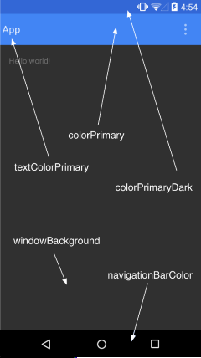
Style Changing AppTheme styles
10
Status Bar
AppTheme is the base application theme.
You can use it to change any default attribute including:
App Bar
<style name="AppTheme" parent="Theme.AppCompat.Light.DarkActionBar"> <item name="colorPrimary">AppBarColor</item> <item name="colorPrimaryDark">StatusbarColor</item> </style>

Slide 11
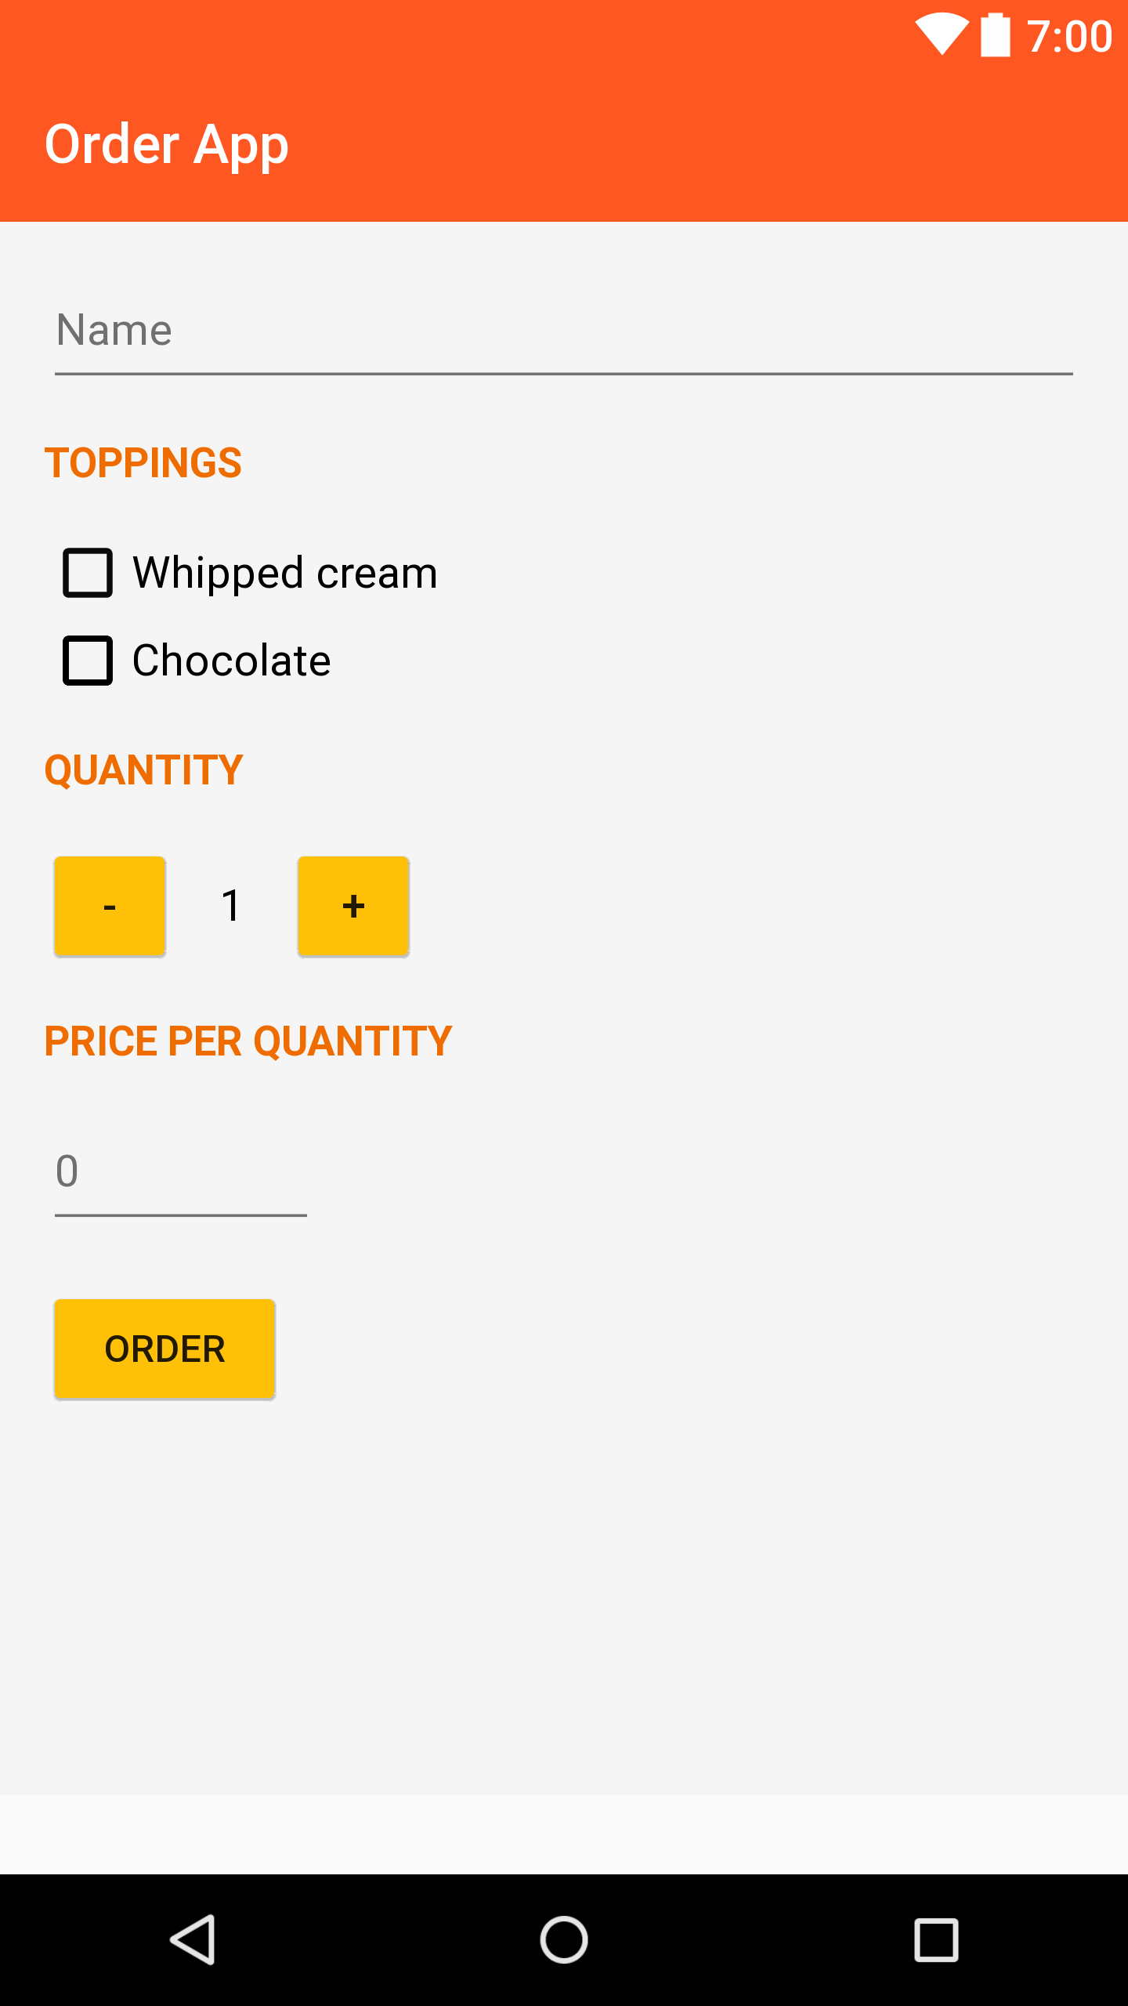
Style Order App Changing Application Theme
11
Modify the default theme in styles.xml. You can pick different colors form here:
<style name="AppTheme" parent="Theme.AppCompat.Light.DarkActionBar"> <item name="colorPrimary">#FF5722</item> <item name="colorPrimaryDark">#FF5722</item> <item name="colorAccent">#CDDC39</item> <item name="colorButtonNormal">#FFC107</item> </style>

